Slide 1
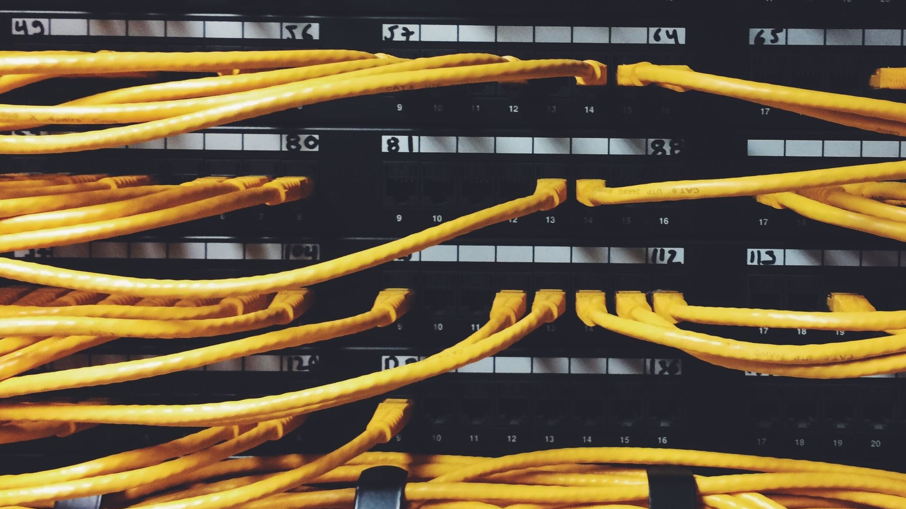
Data Communications

Slide 2

CONCEPT OF COMMUNICATION
Data communication refers to the exchange of data between two or more networked or connected devices.
These devices should be capable of sending and receiving data over a communication medium.
Example given:
Personal computers
Mobile phones
Laptops etc.

Slide 3
COMPONENTS OF DATA COMMUNICATION
Sender:
A sender is any such device which is capable of sending data over a network.
It can be a computer, mobile phone, smartwatch etc.
Receiver:
A receiver is any such device which is capable of receiving data from the network.
It can be any computer, laptop, television etc.
In computer communication sender and receiver are known as nodes in a network.

Slide 4
Message:
It is the data or information that needs to be exchanged between the sender and the receiver.
Messages can be in the form of text, number, image, audio, video, etc.
Communication media:
It is the path through which the message travels between source and destination.
It is also called medium or link which is either wired or wireless.

Slide 5
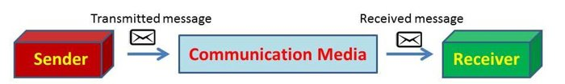

Slide 6
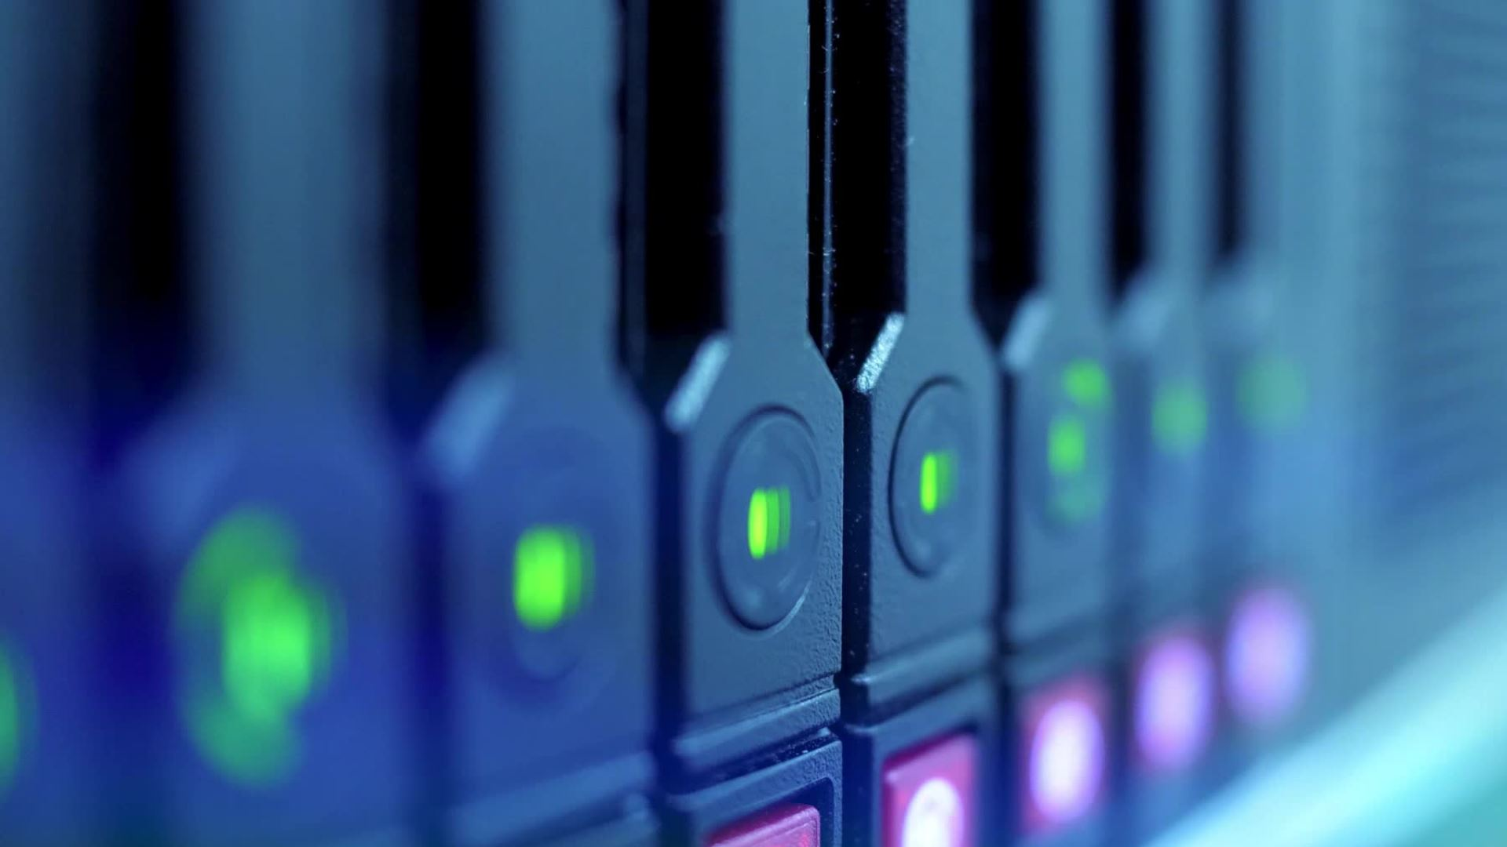
BAUD
It is the unit of measurement for the information carrying capacity of a communication channel. The baud is synonymous with bps (bits per second), another unit of measuring data transfer rates.
NOTE:
Data Channel is the medium used to carry information or data from one point to another

Slide 7
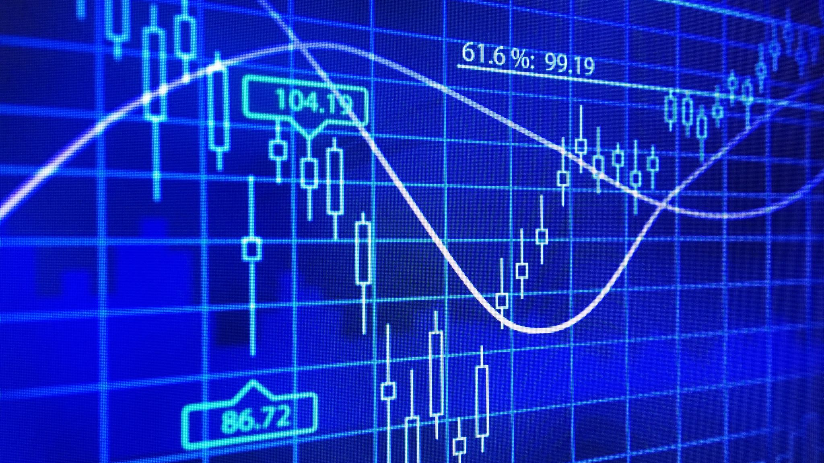
Bits Per Second (bps)
It refers to the speed at which data transfer is measured. It is generally used to measure the speed of information through a high speed phone lines or modems.
Bytes per second are denoted as Bps-notice the capital B.
Small b i.e., bps stands for bits per second.

Slide 8
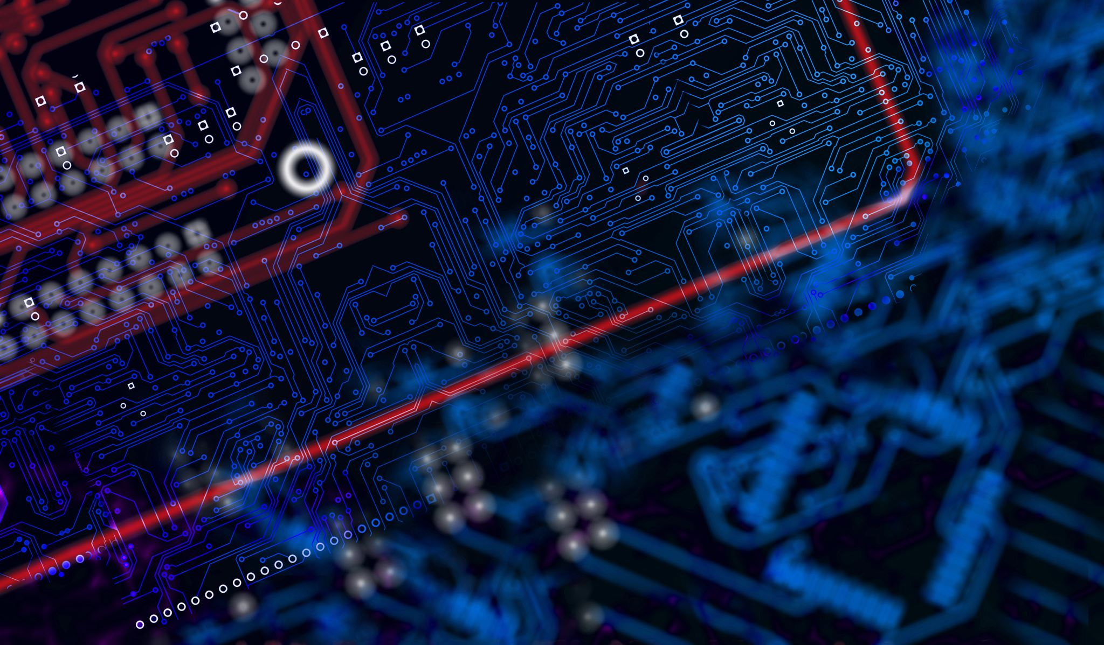
BANDWIDTH
Technically, the bandwidth refers to the difference between the highest and lowest frequency of a transmission channel. Or in other words, the bandwidth refers to the width of allocated band of frequencies to a channel.
Generally speaking, bandwidth is directly proportional to the amount of data transmitted-received per unit time.
For example, it takes more bandwidth to download a photograph in one second than it takes to download a page of text in one second. Large sound files, computer programs, and animated videos require still more bandwidth for acceptable system performance.

Slide 9
In digital systems, bandwidth is data speed in bits per second (bps). Thus, a modem that works a 57,600 bps has twice the bandwidth of a modem that works at 28,800 bps.
In analog systems, bandwidth is defined in terms of the difference between the highest frequency signal component and the lowest-frequency signal component. Frequency is measured in cycles per second i.e., hertz.
A typical voice signal has a bandwidth of a three kilohertz (3 kHz); an analog television (TV) broadcast video signal has a bandwidth of six megahertz (6 MHz) - approximately 2,000 times as wide as the voice signal.

Slide 10
Data Transfer Rates
The data transfer rate represents the amount of data transferred per second by a communications channel or a computing or storage device. Data rate is measured in units of bits per second (bps), bytes per second (Bps), or baud.
Multiplier Prefixes
Date rates- "kilo-", "mega-", "giga-", "tera-" etc.
Eg. 6 kbps is 64 kilo bits per second (64000 bps)
Storage- increase successively with 1024 times.
Eg. 1 MB = 1024 kilobytes; 1 GB = 1024 megabytes

Slide 11

Switching Techniques

Slide 12
What is meant by Switching Techniques?
These are a type of techniques used to connect the sender and receiver so that one-to-one communication is possible.
In this technique , data is routed through various nodes in a network, and forms a temporary route for the data to be transmitted.
Two commonly used switching techniques are — Circuit Switching and Packet Switching.

Slide 13
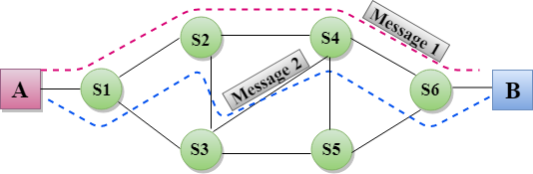
A Visual Representation of Switching Techniques

Slide 14
Any Alternatives? Why just these techniques
Yes, there are many alternatives which include:
To make a dedicated connection between each pair of devices (mesh topology)
To make a dedicated connection between a central device and every other device (star topology)
#However, such methods are costly in case of large networks, thus the most effective method are switching techniques.

Slide 15
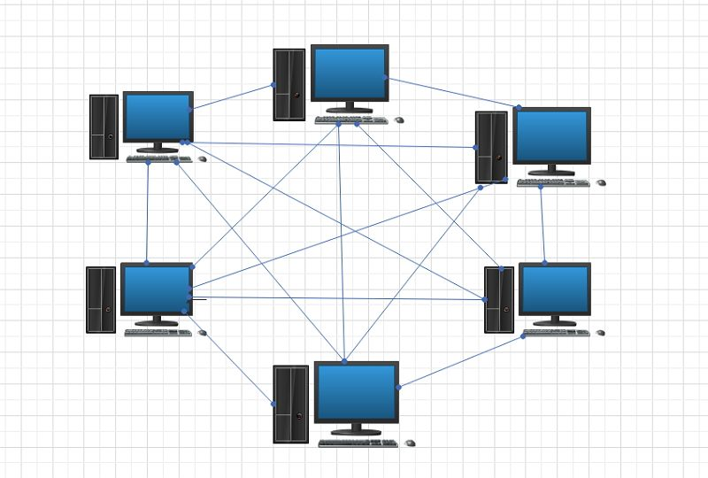
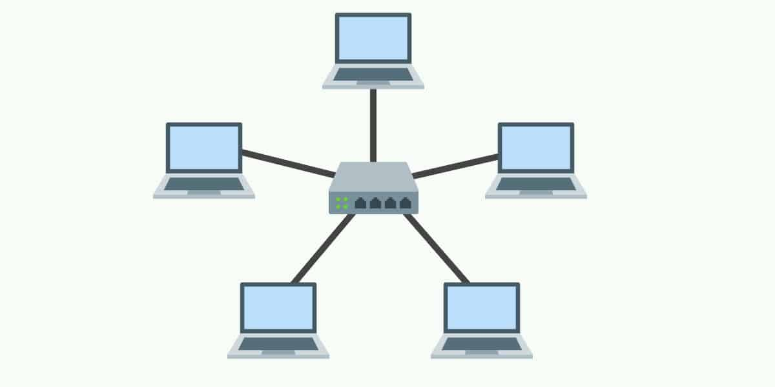
Mesh Topology
Star Topology

Slide 16
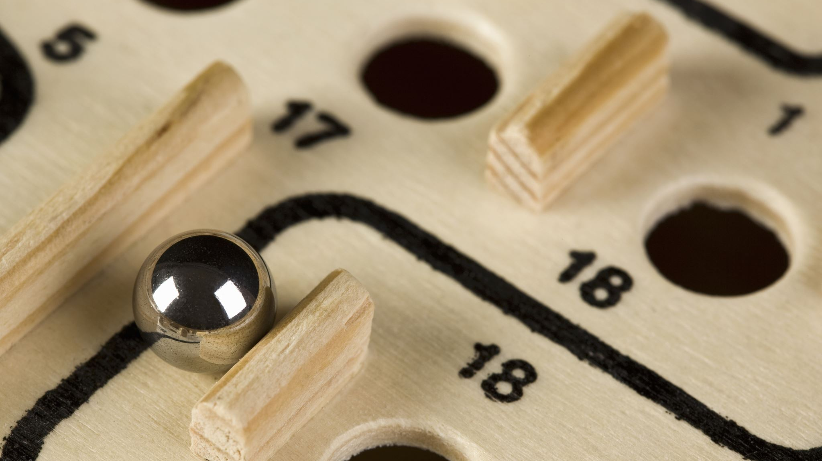
Types of Switching Techniques

Slide 17
1. Circuit Switching
1. In circuit switching, before a communication starts, a dedicated path is identified between the sender and the receiver.
2. This path is a connected sequence of links between network nodes.
3. All packets follow the same path established during the connection. (packets are chunks of information)
Eg : In earlier days, when we placed a telephone call, the switching equipment within the telephone system finds out a physical channel all the way from our telephone at home to the receiver’s telephone.

Slide 18
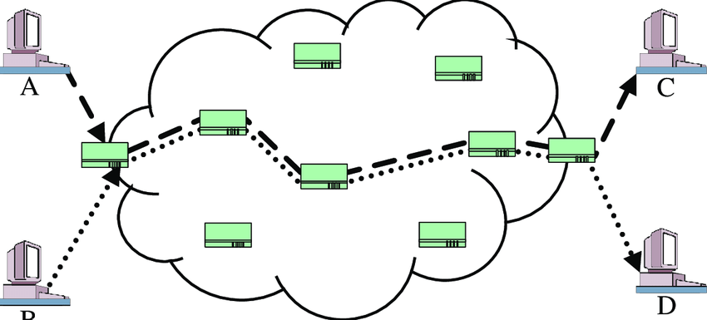
Circuit Switching

Slide 19
2. Packet Switching
1. In packet switching, each information or message to be transmitted between sender and receiver is broken down into smaller pieces, called packets.
2. These packets are then transmitted independently through the network.
3. Different packets of the same message may take different routes depending on availability.

Slide 20

Important points on Packet Switching
Each packet has two parts — a header containing the address of the destination and other information, and the main message part.
When all the packets reach the destination, they are reassembled and the complete message is received by the receiver.
Unlike circuit switching, a channel is occupied in packet switching only during the transmission of the packet. On completion of the transmission, the channel is available for transfer of packets from other communicating parties.

Slide 21
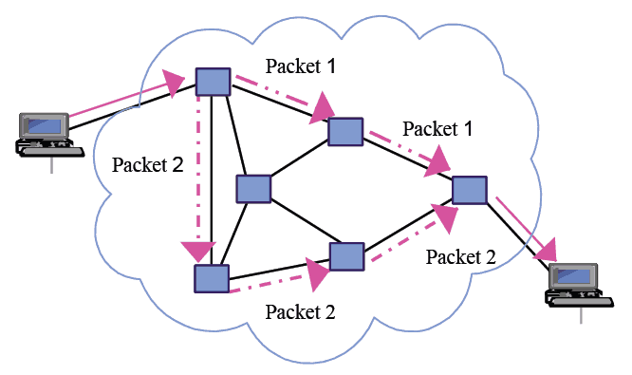
Packet Switching

Slide 22
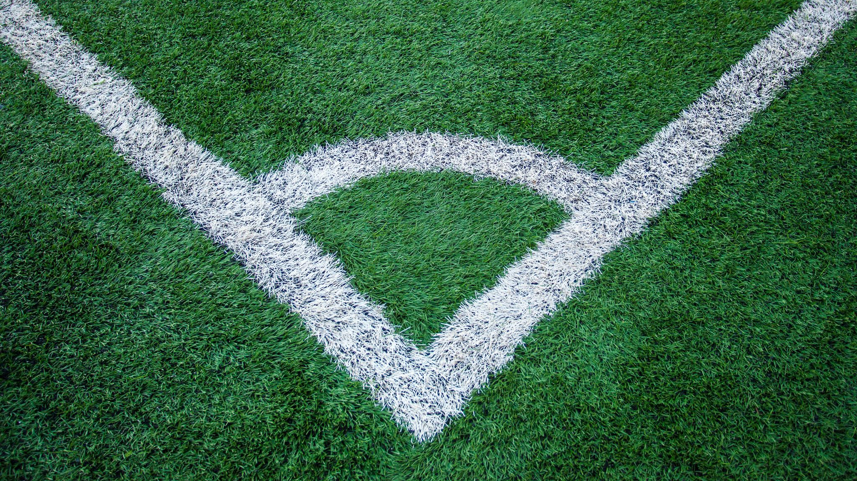
Protocol

Slide 23
Protocol
In communication, Protocol is a set of standard rules that the communicating parties — the sender, the receiver, and all other intermediate devices need to follow.
We need protocols for different reasons such as flow control, access control, addressing, etc.
Flow control is required when the sender and receiver have different speeds of sending and receiving the data.

Slide 24
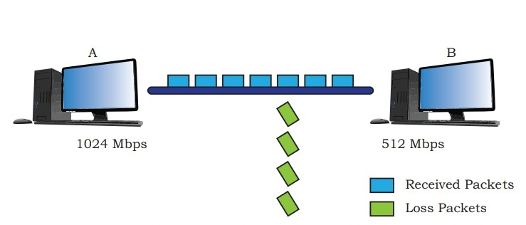
Computer A is sending data at the speed of 1024 Mbps and computer B is receiving data at the speed of 512 Mbps.
In this case, Computer B must be able to inform computer A about the speed mismatch so that computer A can adjust its data transmission rate. Otherwise some data will be lost

Slide 25
Protocols also define
how computers identify one another on a network. the form to which the data should be converted for transit.
how to decide whether the data received is for that node or to be forwarded to another node.
ensuring that all the data have reached the destination without any loss.
how to rearrange the packets and process them at the destination.

Slide 26
Some important protocols are:
Hypertext transfer protocol (HTTP)
File Transfer Protocol (FTP)
Point to Point Protocol (PPP)
Simple Mail Transfer Protocol (SMPT)
Transmission Control Protocol (TCP)/ Internet Protocol (IP)
# We shall study Transmission Control Protocol(TCP)/ Internet Protocol (IP)

Slide 27
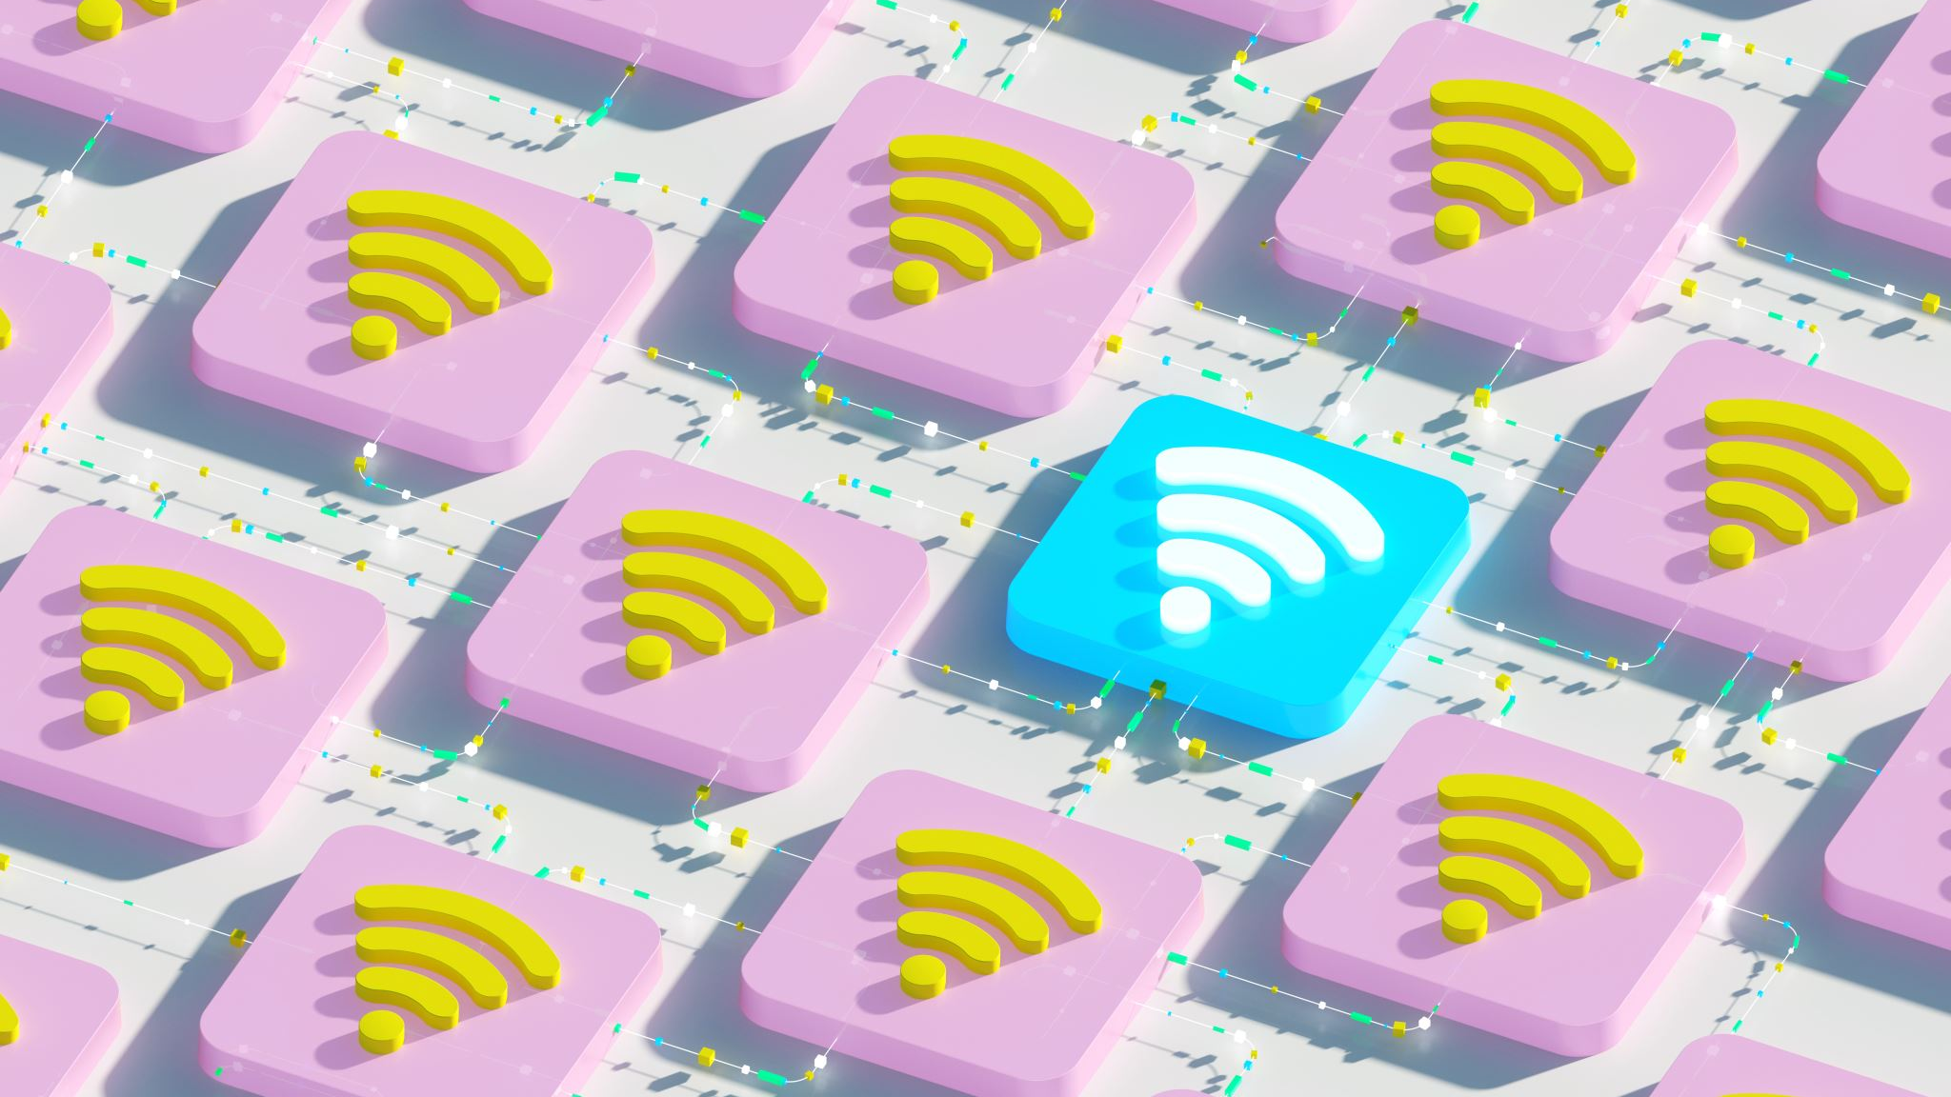
Internet Protocol

Slide 28

Transmission Control Protocol (TCP)/ Internet Protocol (IP)
It is a set of standardized rules that uses a client-server model of communication in which a user or machine (a client) requests a service by a server in the network.
The IP protocol ensures that each computer or node connected to the Internet is assigned an IP address, which is used to identify each node independently.(IP Address is like Aadhar Card for any node)
TCP ensures that the message or data is broken into smaller chunks, called IP packets.
Each of these packets are routed (transmitted) through the Internet, along a path from one router to the next, until it reaches the specified destination

Slide 29
TCP guarantees the delivery of packets on the designated IP address. It is also responsible for ordering the packets so that they are delivered in sequence.
#1. There are many connection path in Internet so, there are many possible paths between two hosts. Hence, two packets of the same message can take two different routes depending on congestion and other factors in different possible routes.
#2.When all the packets finally reach the destination machine, they are reassembled into the original message at the receiver’s end.

Slide 30

Thank you
Made by :
Sannidhya Sahoo
Mohd Sahil
Sachin Duhan
Vibhas Reddy
Bhargav Dinesh

